Slide 1


Team 8
James Hu
Jasmine He
Kimberly Konnoth
Derek Lee
Jessica Ng

Slide 2



Agenda
Industry Overview
Company Analysis
Recommendation
Execution
Industry
Company
Recommendation
Execution

Slide 3
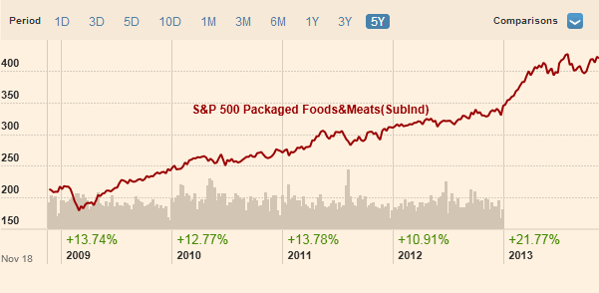
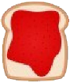
Packaged Foods & Meat Industry
Industry
Company
Recommendation
Execution

Slide 4
Competitor Performance
Industry
Company
Recommendation
Execution

Slide 5
Product Line Competition
Smuckers Brand | Competition
Folgers | Private labels, Maxwell House, Yuban, Nescafe
Millstone/Folgers Gourmet/Dunkin Donuts | Private labels, Starbucks, Gevalia, Eight O’Clock, Seattle’s Best, Peet’s Coffee & Tea
K-Cup | Green Mountain, Starbucks, Maxwell House, Gevalia, private labels
Jif | Skippy, Peter Pan, private labels
Smuckers Fruit Spread | Welch’s, private labels
Crisco | Strong leader for shortening; competes heavily with private labels for oil
Pillsbury | Betty Crocker, Duncan Hines, private & regional brands
Hungry Jack | National & private label brands
Industry
Company
Recommendation
Execution

Slide 6
SWOT Analysis
Strength
- Interactive website
- Accessible products
- Positive consumer response to product innovations
- Improving economy leads to increase in consumer spending
Weakness
- Minimal marketing/advertising
- Lack of brand awareness
- No specific target market
- Ineffective reach to NE region
Threats
- Competitors competing to gain market share
- Health conscious consumers
- Rising lease prices
- Price sensitivity related to raw material costs
Opportunity
- Marketing campaign to raise brand awareness
- Growing industry in packaged foods
- Establishing brand loyalty
Industry
Company
Recommendation
Execution

Slide 7
STP Analysis
Segment
Lunch
Snacks
Desserts
Target
Families
Positioning
A company that offers consumers quality products that brings families together to share memorable meals and moments
Industry
Company
Recommendation
Execution

Slide 8

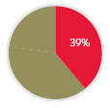
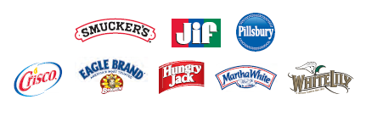
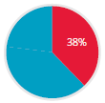
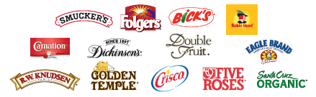
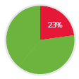
Three Segments
U.S. Retail Coffee
U.S. Retail Consumer Foods
International, Foodservice and Natural Foods
Industry
Company
Recommendation
Execution

Slide 9
Current Marketing Initiatives
Increase in marketing support
Launch of ~100 new products
Sponsorship of the 2014 and 2016 U.S. Olympics & Paralympics teams
New advertisements
Digital Investments
Industry
Company
Recommendation
Execution

Slide 10
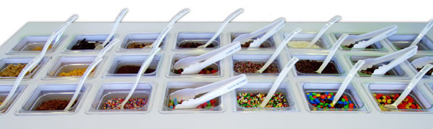
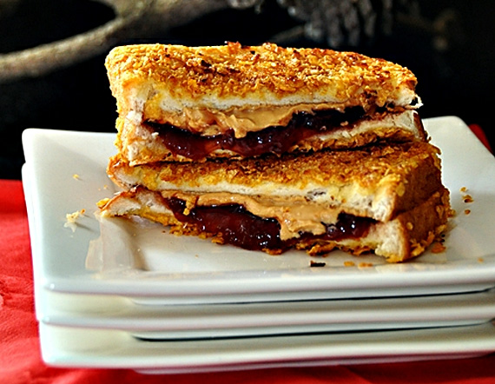
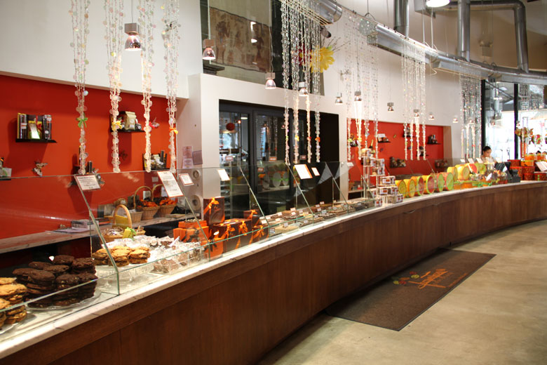
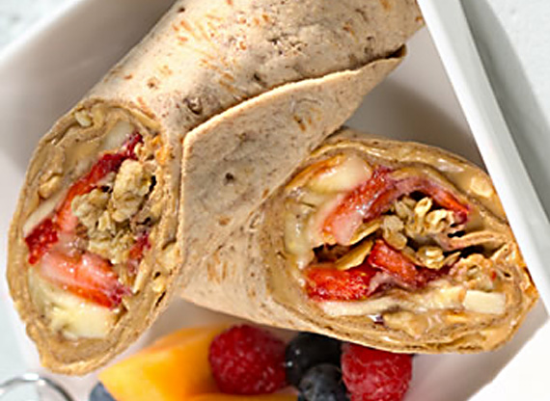
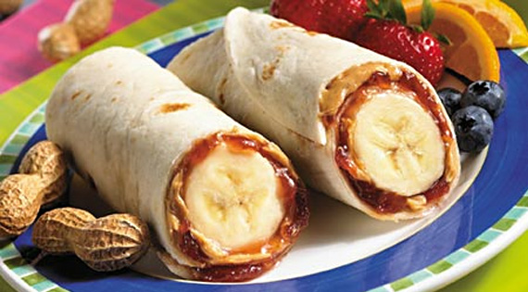
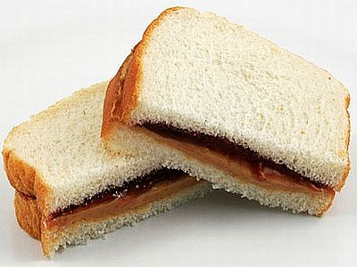
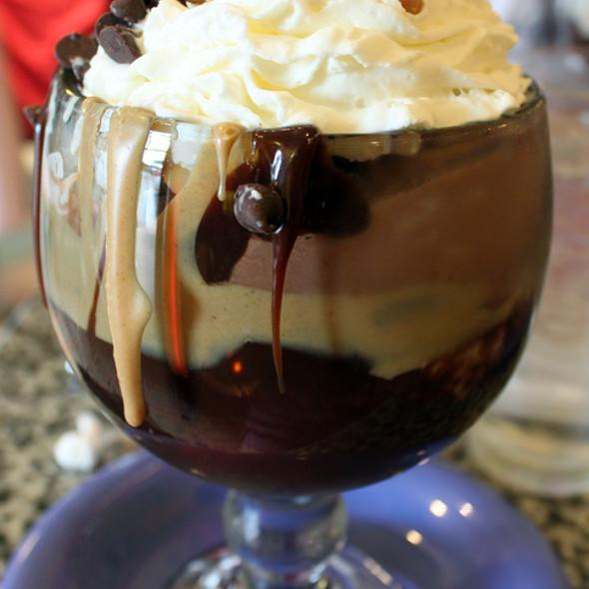
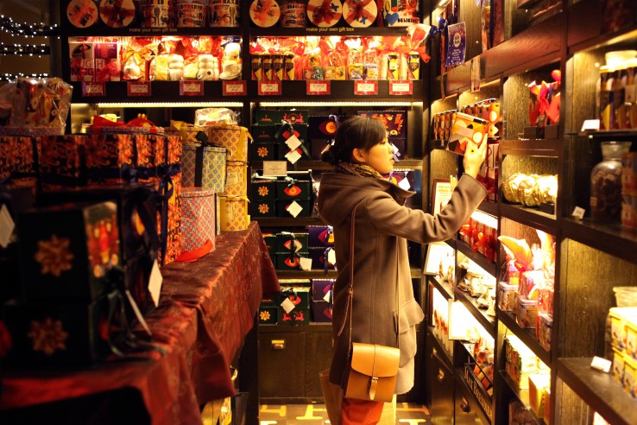
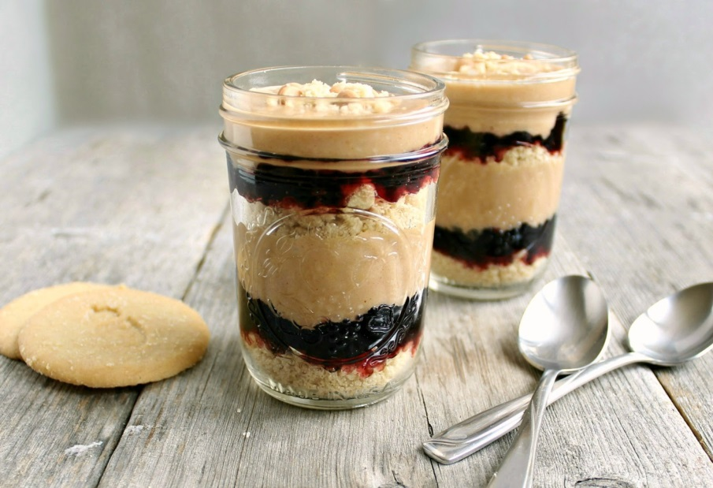
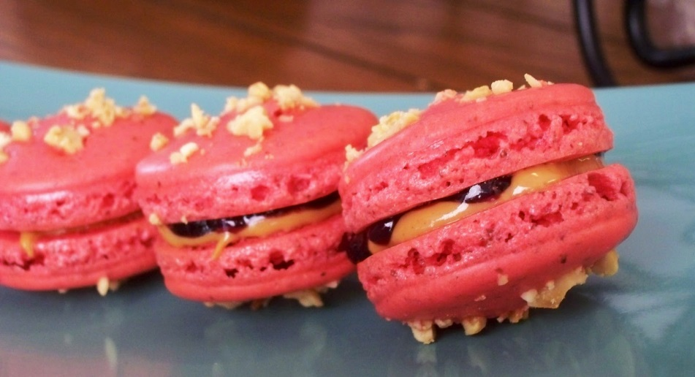
The Smucker’s Store
Industry
Company
Recommendation
Execution

Slide 11
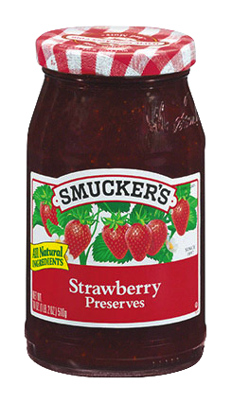
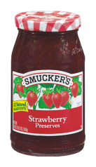
Building Brand Awareness
Innovative Flavors
Excites consumers
Product Variety
Encourages sampling
Product Sales
SoHo Location
Prime visibility and foot traffic
Industry
Company
Recommendation
Execution
Notes:
Brand Awareness
1. Location in Soho → increased visibility and foot traffic.
2. Variety of Product Offerings → encourages sampling of different products.
3. Innovation → excites consumers about Smucker’s.
Boost in Sales would be greater than the amount of revenue we would gain from store sales.

Slide 12
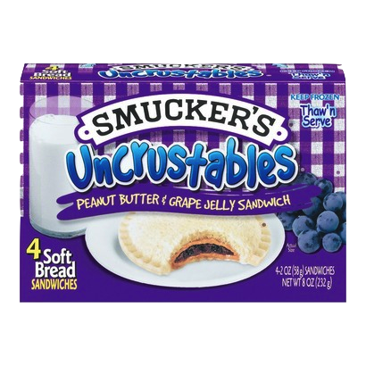


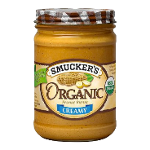
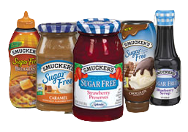
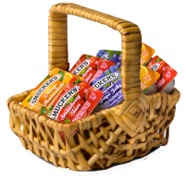
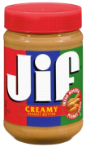
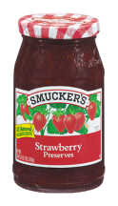
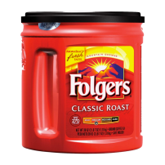



Make An Impact
Sundays
Industry
Company
Recommendation
Execution
Notes:
Smucker’s Sundays → sponsored by Smucker’s bi-annually in September and January.
What we want to do is donate 100% of our profits to the National Military Family Association in the form of monetary donations as well as in Smucker’s products.
Smucker’s Sundays → chance for Military Families to get together and enjoy the food made by Smucker’s.
National Military Family Association is the only national organization that for more than 40 years has represented officer and enlisted families of the Army, Navy, Air Force, Marine Corps, Coast Guard, National Oceanic and Atmospheric Administration, and Public Health Service. We help those seeking resources for: themselves and combat-weary service members returning home from war with fragile mental heath, for optimistic-but-anxious children separated from parents during deployments, for spouses forging ahead with educations to build better lives for their families or to prepare for the unthinkable, for widows seeking information about benefits available to them as they cope with their losses, and for proud parents of single service members. We identify and work with others to resolve emerging military family-related issues.
Facts-
-Since 2001, more than 2 million children have had a parent deployed once.

Slide 13
Organization Legitimacy
7.8%
7.2%
Rated 63.01/70 based on Financials, Accountability, and Transparency.
-Charity Navigator
85.1%
Industry
Company
Recommendation
Execution
Notes:
Rated 63.01/70
Rated better than many of other organizations that do the same work.
3. Financials/Expenses make sense and are transparent.
Facts-
-Since 2001, more than 2 million children have had a parent deployed once.
-

Slide 14



Why Take No Profits?
Profit Generated Through 1 Store
Increase in Product Sales
Industry
Company
Recommendation
Execution
Notes:
If we decided to take all of the profits we make from this one store, we would be losing out on the potential increase in product sales as a result of giving back to the community.

Slide 15
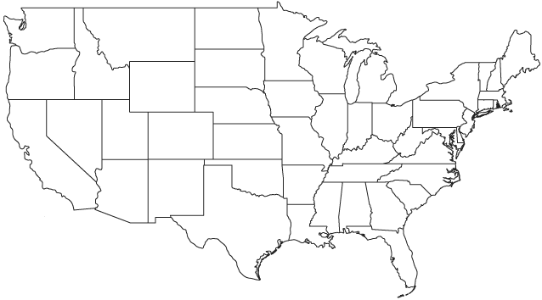
Reaching Target Audience
Impacting Families
Building Preference for Smucker’s Products
Increase in Long-Term Sales
Percentage of people w/
immediate family member
serving in the military:
Ages 18-29: 33%
Ages 30-49: 57%
Ages 50-64: 79%
Ages 65+: 74%
Industry
Company
Recommendation
Execution

Slide 16
Timeline
2014
2015
2016
2017
2018
Q1 Q2 Q3 Q4 | Q1 Q2 Q3 Q4 | Q1 Q2 Q3 Q4 | Q1 Q2 Q3 Q4 | Q1 Q2 Q3 Q4
Planning & Construction
Store Implementation
Summer CSR
Summer CSR
Summer CSR
Summer CSR
Summer CSR
Final Evaluation
Full Study
Preliminary Evaluation
Mid-project
Evaluation
Industry
Company
Recommendation
Execution

Slide 17
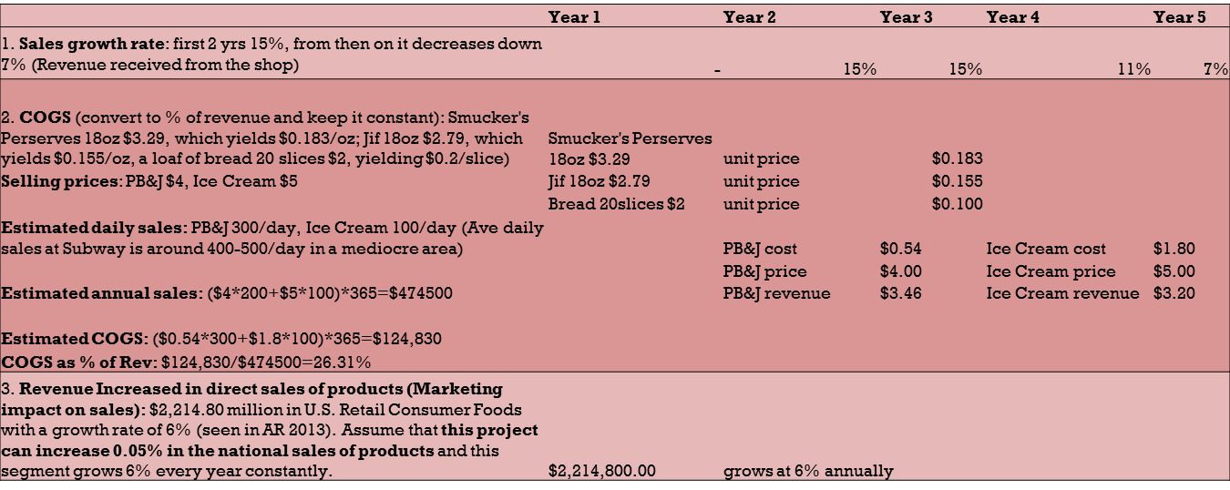
Assumptions
Industry
Company
Recommendation
Execution

Slide 18
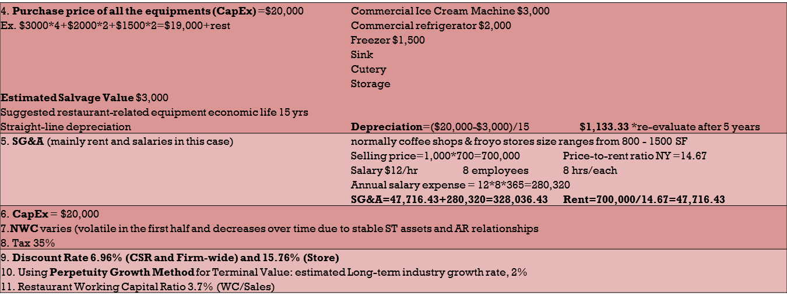
Assumptions Cont.
Industry
Company
Recommendation
Execution

Slide 19
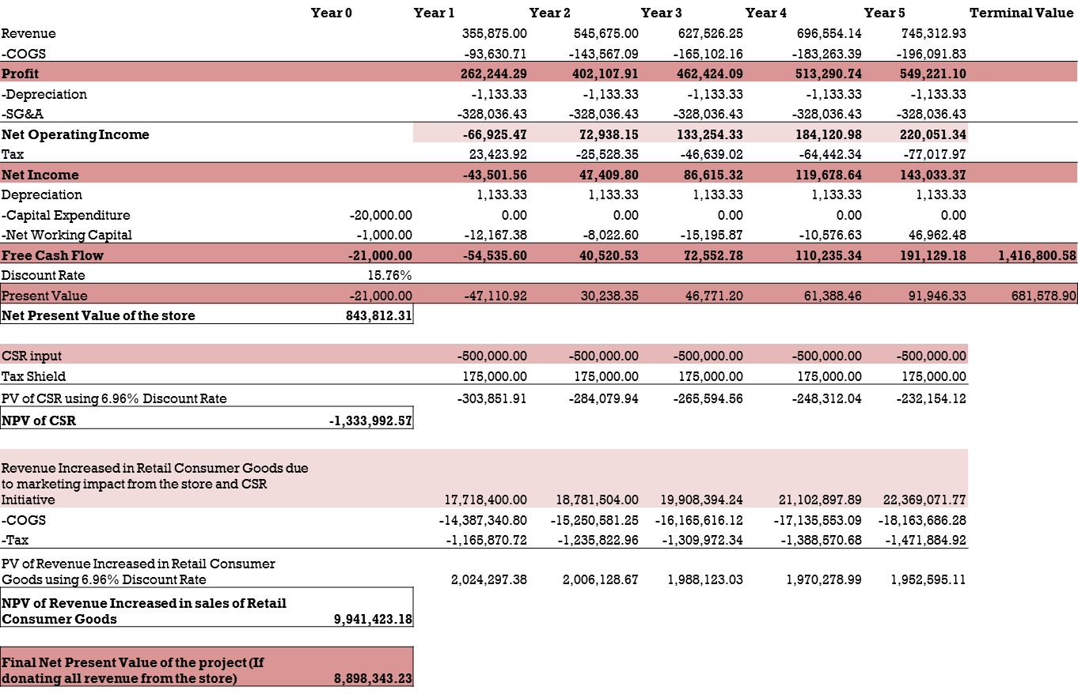
NPV Analysis
Industry
Company
Recommendation
Execution

Slide 20
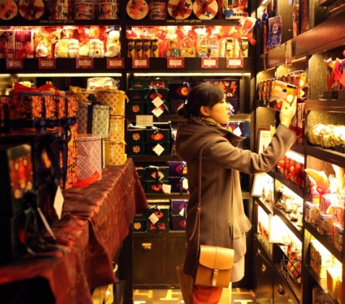

Summary
Slowing Sales
Price Sensitivity
Strong Competition
Innovation
Visibility
Growth
Industry
Company
Recommendation
Execution

Slide 21
Questions?

Slide 22
Appendix A: Industry Comparison
Top Processed & Packaged Goods Companies by Market Cap
Company | Symbol | Price | Change | Market Cap | P/E
General Mills, Inc. | GIS | 51.31 | ↓0.43% | 32.54B | 19.22
Kellogg Company | K | 62.61 | ↓1.09% | 22.68B | 23.94
Mead Johnson Nutrition Company | MJN | 84.85 | ↑4.91% | 17.14B | 27.38
ConAgra Foods, Inc. | CAG | 33.00 | ↓0.18% | 13.92B | 20.95
Campbell Soup Company | CPB | 42.42 | ↓0.28% | 13.30B | 29.44
The J.M. Smucker Company | SJM | 109.35 | ↑0.39% | 11.50B | 21.04

Slide 23
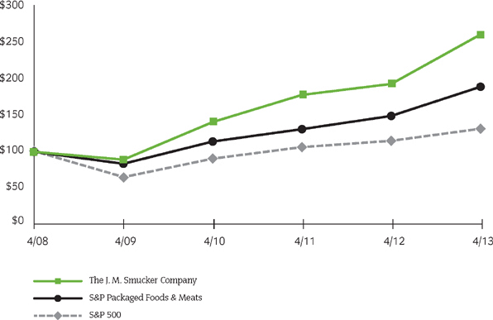
Appendix B: Market Comparison

Slide 24
Appendix C: Financial Performance
 | Year Ended April 30
(Dollars in millions, except per share data) | 2013 | 2012 | 2011
Statements of Income:
Net Sales | $5,897.70 | $5,525.80 | $4,825.70
Gross Profit | $2,027.60 | $1,845.20 | $1,798.50
% of net sales | 34.40% | 33.40% | 37.30%
Operating Income | $910.40 | $778.30 | $784.30
% of net sales | 15.40% | 14.10% | 16.30%
Net Income | $544.20 | $459.70 | $479.50
Financial Position:
Cash & Cash Equivalents | $256.40 | $229.70 | $319.80
Total Assets | 9,031.80 | 9,115.20 | $8,324.60
Total Long-Term Debt | 2,017.80 | 2070.5 | $1,304.00
Shareholders' Equity | 5,148.80 | 5163.4 | $5,292.30
Liquidity:
Net Cash Provided by Operating Activities | $855.80 | $730.90 | $391.60
Capital Expenditures | 206.50 | $274.20 | 180.10
Free Cash Flow | 649.30 | $456.70 | 211.50
Quarterly Dividends Paid | 222.80 | $213.70 | 194.00
Purchase of Treasury Shares | 364.20 | $315.80 | 389.10
EBITDA | 1,161.60 | 1028.00 | 1,023.90

Slide 25
Appendix D: Risks
Issue | Risk Level | Strategy
Kids don’t want our products | Medium | Making our products look good through product design
Price sensitivity to our products | Medium | Mitigation through increased variety
Whether plan translates into sales | Medium | Through reevaluation of strategies during key points of project duration
Completely does not resonate with consumers | High | Evaluations to try and adjust. Short horizons and relatively low investments to mitigate problems

Slide 26
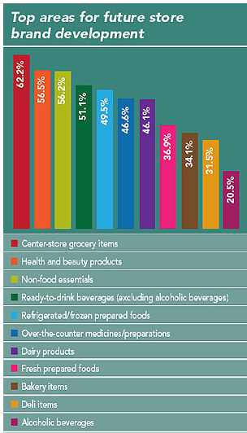
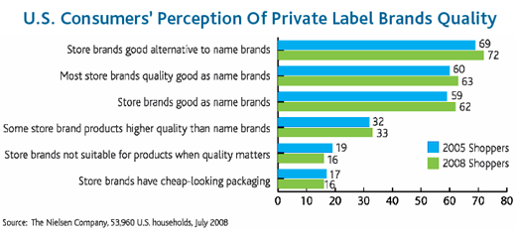
Appendix E: Threat of Private Brands

Slide 27
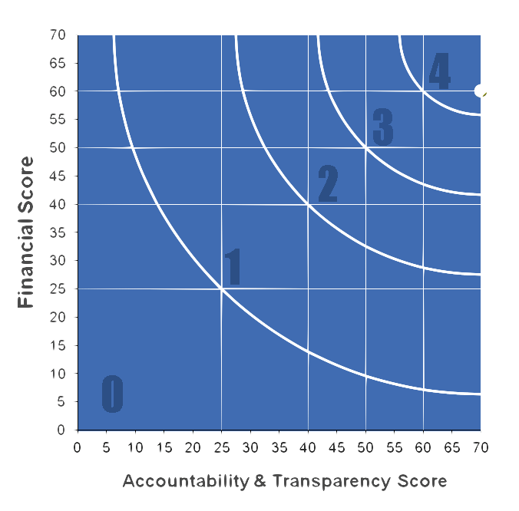
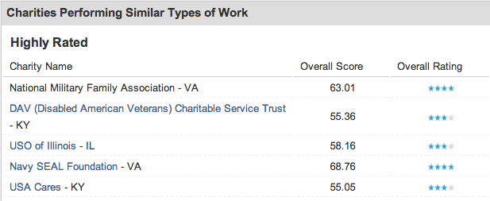
Appendix F: Organization Legitimacy

Slide 28
References

Slide 29
References
http://www.militaryfamily.org/
http://www.dosomething.org/tipsandtools/11-facts-about-military-families
http://www.charitynavigator.org/index.cfm?bay=search.summary&orgid=7587#.UoweyGTwJ0N
http://www.plstorebrands.com/article-eye_on_growth-5578.html
https://www.facebook.com/l.php?u=http%3A%2F%2Fmoney.msn.com%2Ftop-stocks%2Fpost.aspx%3Fpost%3De7f3d729-b781-427d-a902-8a273cfa4155&h=8AQFhIVua
http://csimarket.com/stocks/fundamentals_glance.php?code=SJM
http://www.mrchocolate.com/news/about/locations/hudson-street/
http://www.jmsmucker.com/investor-relations
http://www.forbes.com/sites/davidmarotta/2012/03/19/capm-the-first-factor-of-investing/
http://finance.yahoo.com/q/ks?s=SJM
http://www.petalsandpastries.net/price-list/
http://www.yelp.com/biz/ice-cream-lab-beverly-hills
http://ezinearticles.com/?Is-Americas-1-Franchise,-Subway,-Worth-the-Investment?&id=2780832
http://www.jmsmucker.com/investor-relations/ShareholderServices/investor-information
http://www.jesrestaurantequipment.com/product.asp?itemid=30817&utm_source=googleshopping&gclid=CLfEzO_F8roCFcc7OgodvlMANQ
http://www.irs.gov/publications/p946/ch04.html
http://www.franchisechatter.com/2013/06/14/franchise-costs-2013-detailed-estimates-of-pinkberry-franchise-costs-2013-fdd/
http://pages.stern.nyu.edu/~%20adamodar/New_Home_Page/datafile/wcdata.html
http://www.propertyshark.com/mason/ny/New-York-City/Maps
http://money.cnn.com/real_estate/storysupplement/price_to_rent/

